Slide 1

Title III Reporting Instructions

Slide 2
Timeline
Before Award
  The budget page will be completed by your organization and turned in with your proposal
After Award
  The budget page will be revised by COAAA with the final grant award
  An invoice file (Microsoft Excel) will be sent to you with the budget page, RFF page, and monthly service report pages
Monthly
  E-mail or fax RFF invoice page and monthly service report page to accounstpayable@coaaa.org or 614-645-7259 by the15th of the month following service

Slide 3
Invoice File-Budget Page
This worksheet sent to you should show the following:
Agency name, Address, Tax ID, Contract Signatory, and their title
Name of the service, county served, unit of measure, and the total unit cost
The expected grant funds, client contributions, and any other funds.
  Local cash match auto calculates
  Sources of other funds
The client information
Home Repair/Maintenance/Modification ONLY: Entered at $1 for the total unit cost.
  The number of units will be the total expense.
The reimbursable grant rate which auto calculates

Slide 4
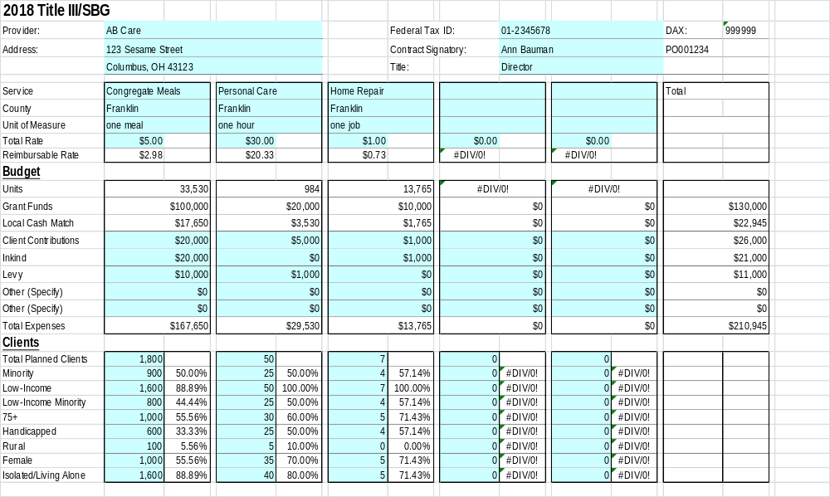
Invoice file-budget page

Slide 5
Invoice File-Month Tabs
The cells shaded in blue are variable each month.
Enter the Units, Clients, and New Clients for the month.
  MEALS ONLY: Report all qualified units even if it exceeds your budget
    You will only be reimbursed for the budgeted amount but the extra meals can help increase funding the following year.
  Do NOT report units in excess of your budget for any other service
    This does NOT increase funding and creates reporting issues
  Home Repair/Maintenance/Modification ONLY: The number of units will be the total expense (ex. $550.00 will be 550 units at $1 each).
Grant funds and local cash match will automatically calculate
Enter the Client Contributions, InKind, and any other funds.
The YTD expense will show the percentage of your budget used. All funding sources should be close to the percentage on line 28.
  If your budget for other funding sources changes please send a change request to games@coaaa.org with a brief explanation.

Slide 6
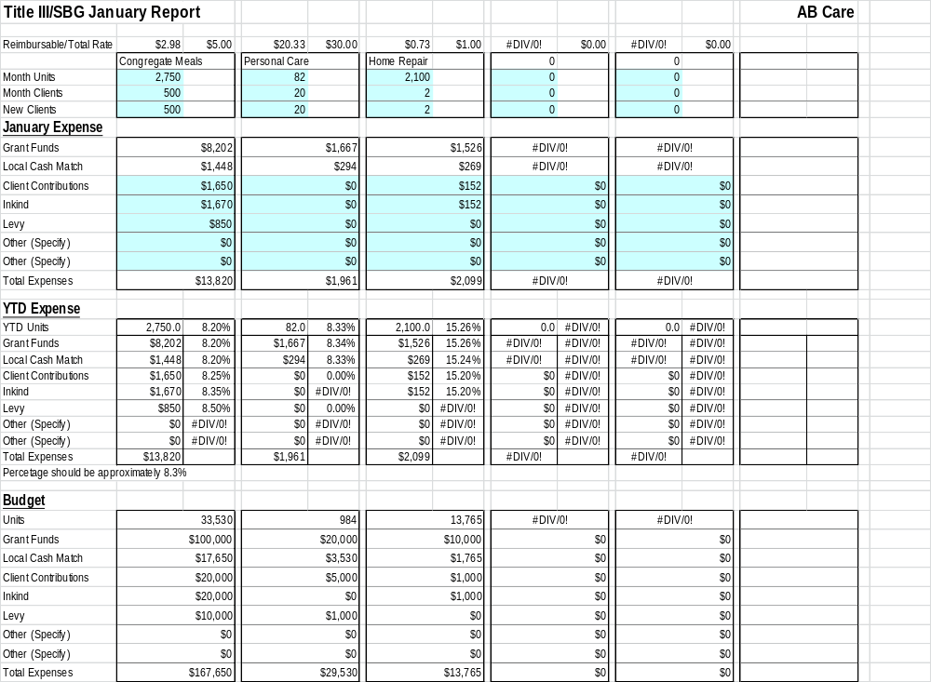
Invoice file-month tabs
This is ideal. The percentages are about equal and on pace with the monthly estimate.
The client contributions and other funds are not on pace with the grant expenses. You will need to document the reason for the difference.
This is acceptable since all funding sources are about equal. Monthly expenses can fluctuate from month to month so they will not necessarily match the projection percent. COAAA may limit the monthly reimbursement if the amount is too far off the projection percent.

Slide 7
Invoice file-request tab
Enter the Month Ending, Prepared By, Date, Phone, E-Mail, Agency Name, and Address
Enter only the payments received. DO NOT ENTER THE CURRENT PAYMENT REQUEST.
Print and sign request page each month.

Slide 8
Invoice submission
Signed “Request” page from Excel
Month page from Excel
Copy of journal entry for any client contributions or program income.
SAMS service deliveries must be entered
  You do not have to send SAMS reports with your monthly invoice.
  Discrepancies between SAMS and submitted reports must be resolved before payment can be processed.
Please contact Mandy Garrett with questions: 614-645-7259 or accountspayable@coaaa.org

