Slide 1

SAMS Notes for Providers
Title III and Alzheimer’s Respite services

Slide 2
General Information
WellSky/SAMS3/Aging & Disability are all the same company/program
SAMS3 cannot run on Internet Explorer 11.
  Other browsers will most likely work properly.
All Service Deliveries must be entered in SAMS monthly.
Go to the following address: https://portal.wellsky.com/

Slide 3
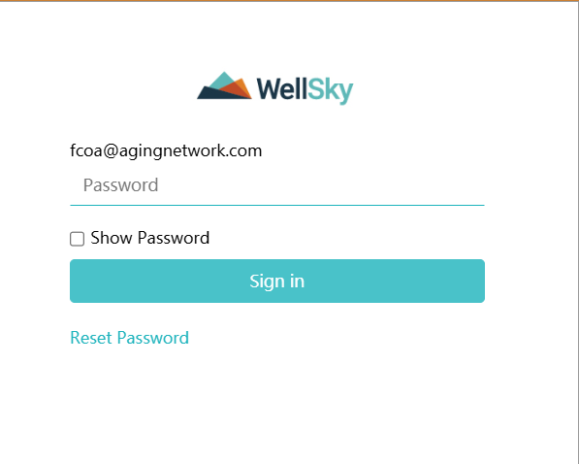
Login
The first login is shared by everyone in your organization.
The e-mail associated with this login is usually your organization’s director
The Password must be updated regularly

Slide 4
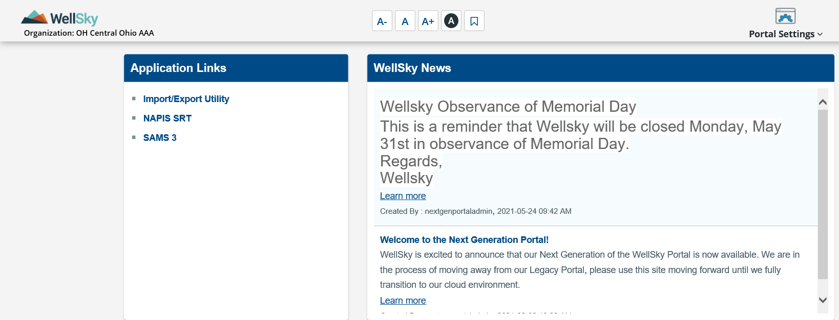
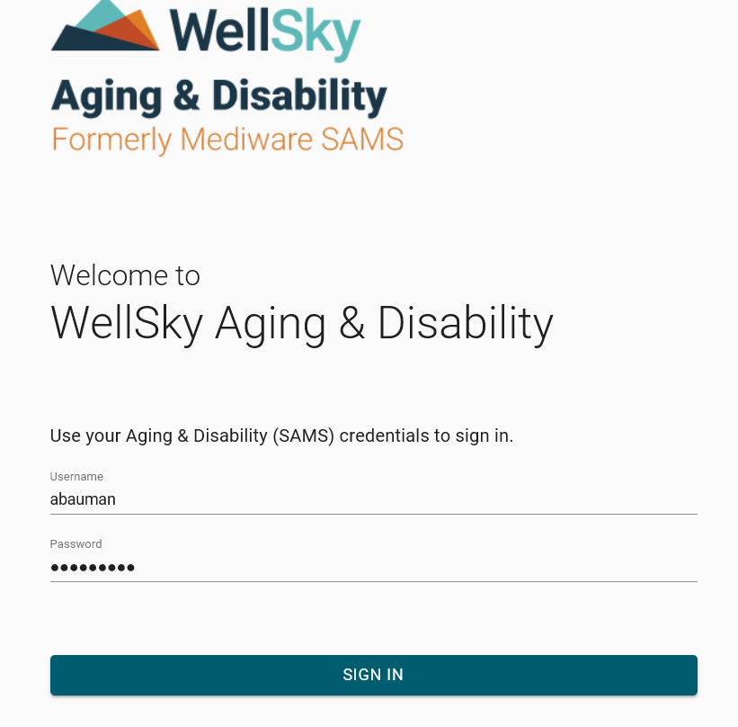
Login
Click on the “SAMS 3” link at the top left corner
You will then log in with your personal user name and password

Slide 5
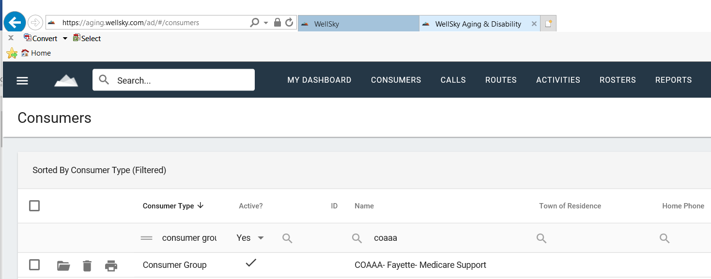
ConsumerS
Search for consumers by entering first and last name in the upper left search box.
You can also enter the SAMS ID if known.
This will search all consumers and caregivers in Ohio so please verify you have the correct consumer before entering or changing information.

Slide 6
Consumers
You will need to set up the consumer if they are not already in SAMS.
  See Adding a Consumer.pdf document for details on this process.
The Default Agency in the consumer detail screen must be set to “6_Central Ohio Area Agency on Aging”
  The exception would be a consumer who lives outside AAA6 but travels to your location for congregate meals.

Slide 7
Service Deliveries
Service Deliveries must be entered by the 15th of the month following service.
  See Service Deliveries.pdf document for details on this process.
The rate will be the FULL unit rate from your budget.
  This is NOT the rate that you will receive from COAAA. Your monthly payment will be based on the contracted grant reimbursement rate from your budget.
National Family Caregiver Service Deliveries and Alzheimer’s Respite are entered on the caregiver’s detail screen.
All other Service Deliveries are entered on the consumer’s detail screen

Slide 8
Service Deliveries
MEALS ONLY: Report all qualified units even if it exceeds your budget
  You will only be reimbursed for the contracted amount but extra meals can help increase funding next year.
Do NOT report units in excess of your budget for any other service
  This does NOT increase funding and creates reporting issues
Home Repair/Maintenance/Modification ONLY: The number of units will be the total expense
  $550.00 total expense will be 550 units at $1 each
  See your approved budget for the reimbursement rate.

Slide 9
Care Program
Select the correct Care Program
  Traditional OAA for Title III services
  National Family Caregiver Program
  Alzheimer’s Respite
A Local Care Program must be set up if your organization uses SAMS for services not related to COAAA
  A local care program must be selected to exclude the service delivery from COAAA reports and classifications.

Slide 10
Fund Identifiers
Enter a Fund Identifier for each Service Delivery
  The default Fund Identifier for non-meal Title III is IIIB
  The default Fund Identifier for meals is IIIC
  The default Fund Identifier for Caregiver is IIIE
  The default Fund Identifier for Alzheimer’s Respite is … Alzheimer’s Respite
Do Not Change the Fund Identifier once you have saved your service delivery entry.
  COAAA may change the Fund Identifier on some service deliveries after you submit your invoice based on how the payment is allocated.

Slide 11
Miscellaneous
The Service Deliveries must match your monthly service report and invoice (Excel file) before payments can be processed.
No need to send a SAMS summary report with your monthly service report and invoice.
  The exception is if you are a congregate meal provider and have consumers traveling from outside AAA6 to your facility
  These consumers will not show on COAAA reports so a SAMS Agency Summary Report will show verification of units served.
  Consumer names are not necessary on the SAMS summary report.

Slide 12
Resources
Contact Mandy Garrett with questions
  mgarrett@coaaa.org
  614-645-7259
Training materials are available on the COAAA website:
http://www.coaaa.org/cms/for-providers/billing

